Slide 1
Innovative test solution
Provider
- Probe pin Datasheet -

Slide 2
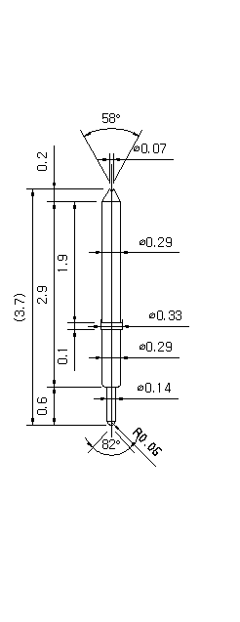
※ Special – POGO pin for High current
IVB-SAR-370-029-A058-00
Pitch | 0.4 mm
Total Length | 3.7 mm
Use Length | 3.3 mm
Use Stroke | 0.4 mm
Recommended Top Plunger Stroke | 0.3 mm
Recommended Bottom Plunger Stroke (Pre-load) | 0.1 mm
Max Stroke | 0.6 mm
Spring Force at Use Stroke | 20 gf at 0.4 mm stroke
Operating Temperature | -40 to +140℃
DC Resistance | Avg. 43.0 mΩ at 0.4 mm stroke
Current Rating (Continuous 1Hour) | 3.0 A
Self Inductance | 1.12nH
Bandwidth @ -1dB | 20.0 GHz
Top Plunger | BeCu / Alloy2-2H
Bottom Plunger | BeCu / Au over Ni
Barrel | PB / Au over Ni
Spring | SUS / Au
Insertion Life | 100,000 cycles at 0.15-0.5 mm stroke

Slide 3
Thank you.

